Slide 1
NLP
Kawin M

Slide 2
Agenda
Topic one
Topic two
Topic three
Topic four

Slide 3

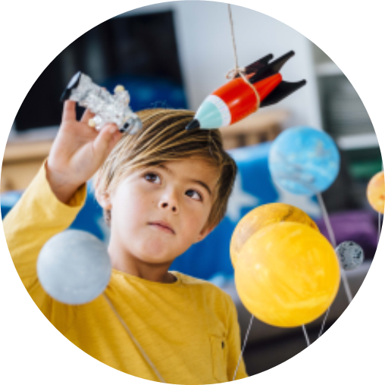
Introduction
With PowerPoint, you can create presentations and share your work with others, wherever they are. Type the text you want here to get started. You can also add images, art, and videos on this template. Save to OneDrive and access your presentations from your computer, tablet, or phone.

Slide 4
A Survey on Knowledge Graphs: Representation, Acquisition, and Applications

Slide 5
Abstract
KG that represent structural relations between entities have become an increasingly popular research direction toward cognition and human-level intelligence.
Contents:
KG representation learning
Knowledge acquisition and completion
Temporal KG
Knowledge-aware applications
Summarize recent breakthroughs

Slide 6
KG
KG is a structured representation of facts, consisting of entities, relationships, and semantic descriptions.
Entities can be real-world objects and abstract concepts, relationships represent the relation between entities, and semantic descriptions of entities, and their relationships contain types and properties with a well-defined meaning.
Property graphs or attributed graphs are widely used, in which nodes and relations have properties or attributes.

Slide 7
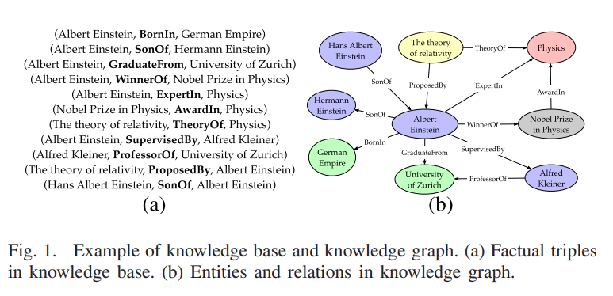
KG and Knowledge Base
Minor difference - A KG can be viewed as a graph when considering its graph structure. When it involves formal semantics, it can be taken as a knowledge base for interpretation and inference over facts.

Slide 8
KG
Knowledge can be expressed in a factual triple in the form of:
(head, relation,tail) or
(subject, predicate, object)
under the Resource Description Framework (RDF).
For example, (Albert Einstein, WinnerOf, Nobel Prize).
It can also be represented as a directed graph with nodes as entities and edges as relations.

Slide 9
Definition of KG
We define a KG as G = {E, R, F}, where E, R, and F are sets of entities, relations, and facts, respectively.
A fact is denoted as a triple (h,r,t) ∈ F.
Definition 1 (Ehrlinger and Wöß [12]):
A KG acquires and integrates information into an ontology and applies a reasoner to derive new knowledge.
Definition 2 (Wang et al. [5]):
A KG is a multirelational graph composed of entities and relations, which are regarded as nodes and different types of edges, respectively.

Slide 10
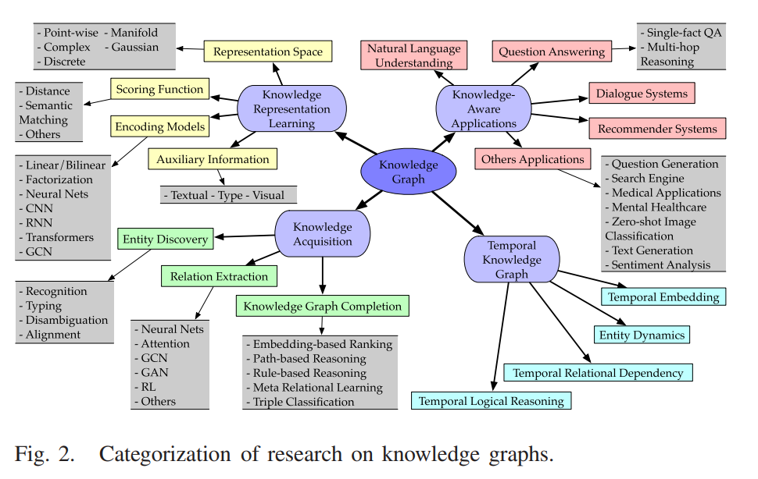
Research on KG

Slide 11
1) Knowledge Representation Learning (KRL)
KRL is also known as KGE (KG Embedding), multirelation learning, and statistical relational learning.
Contents:
Representation space: in which the relations and entities are represented
Scoring function: for measuring the plausibility of factual triples
Encoding models: for representing and learning relational interactions (modeling the semantic interaction of facts)
Auxiliary information: to be incorporated into the embedding methods

Slide 12
A) Representation space
Key Issue: learn low-dimensional distributed embedding of entities and relations.
The embedding space should follow three conditions, i.e.,
Differentiability
Calculation possibility
Definability of a scoring function.

Slide 13
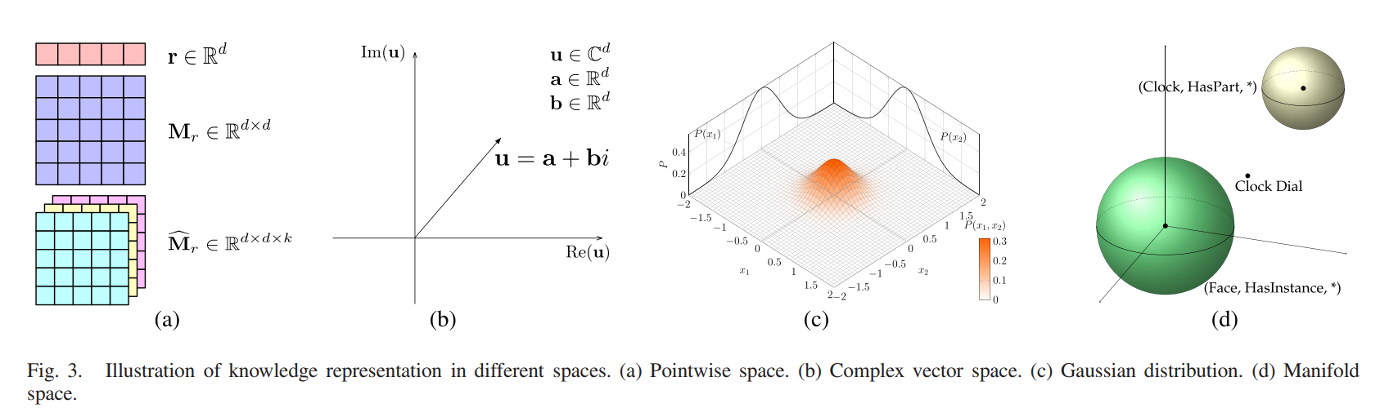
A) Representation space
Types:
Point-wise Space
Complex Vector Space
Gaussian Space
Manifold Space

Slide 14
Point-wise Space
The pointwise Euclidean space is widely applied for representing entities and relations, projecting relation embedding in vector or matrix space, or capturing relational interactions.
TransE:
TransE represents entities and relations in d-dimension vector space, i.e., h,t, r ∈ R^{d} , and makes embeddings follow the translational principle h+r ≈ t.
Problem: Insufficiency of a single space for both entities and relations.

Slide 15
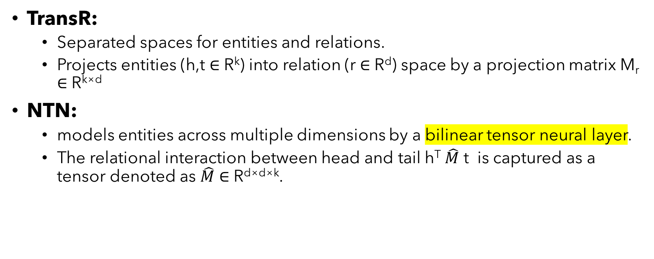
Point-wise Space
TransR:
Separated spaces for entities and relations.
Projects entities (h,t ∈ R^{k}) into relation (r ∈ R^{d}) space by a projection matrix M_{r} ∈ R^{k×d}
NTN:
models entities across multiple dimensions by a bilinear tensor neural layer.
The relational interaction between head and tail h^{T} $\hat{M}$ t is captured as a tensor denoted as $\hat{M}$ ∈ R^{d×d×k}.

Slide 16
Point-wise Space
HAKE:
Instead of using the Cartesian coordinate system, HAKE [19] captures semantic hierarchies by mapping entities into the polar coordinate system, i.e., entity embeddings e_{m} ∈ R^{d} and e_{p} ∈ [0, 2π)^{d} in the modulus and phase part, respectively.
Many other translational models, such as TransH [20], also use similar representation space, while semantic matching models use plain vector space (e.g., HolE [21]) and relational projection matrix (e.g., ANALOGY [22]). Principles of these translational and semantic matching models are introduced in Sections III-B1 and III-B2, respectively.

Slide 17
Complex Vector Space
Instead of using a real-valued space, entities and relations are represented in a complex space, where h,t, r ∈ Cd . Take head entity as an example, h has a real part Re(h) and an imaginary part Im(h), i.e., h = Re(h)+i Im(h).
ComplEx [23]:
Introduced complex vector space.
It can capture both symmetric and antisymmetric relations.
The Hermitian dot product is used to do composition for relation, head, and the conjugate of the tail.

Slide 18
Complex Vector Space
RotatE [24]:
Inspired by Euler’s identity eiθ = cos θ + i sin θ, it proposes a rotational model taking relation as a rotation from head entity to tail entity in complex space as t = h ◦ r, where ◦ denotes the elementwise Hadmard product.
With the introduction of the rotational Hadmard product in complex space, it can also capture inversion and composition patterns, as well as symmetry and antisymmetry.

Slide 19
Complex Vector Space
QuatE [25]:
extends the complex-valued space into hypercomplex h,t, r ∈ H^{d} by a quaternion Q = a + bi + cj + dk with three imaginary components, where the quaternion inner product, i.e., the Hamilton product h ⊗ r, is used as compositional operator for head entity and relation.
uses the Hamilton product to capture latent interdependencies within the 4-D space of entities and relations and gains a more expressive rotational capability than RotatE.

Slide 20
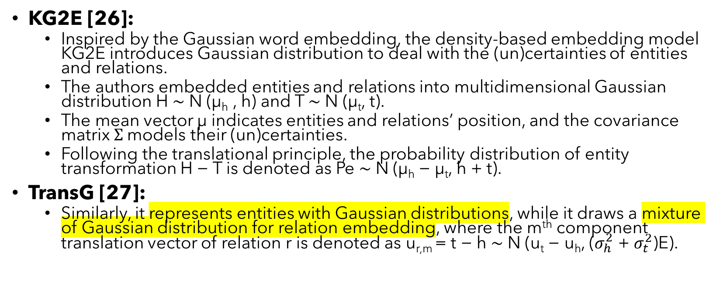
Gaussian Distribution
KG2E [26]:
Inspired by the Gaussian word embedding, the density-based embedding model KG2E introduces Gaussian distribution to deal with the (un)certainties of entities and relations.
The authors embedded entities and relations into multidimensional Gaussian distribution H ∼ N (μ_{h} , h) and T ∼ N (μ_{t}, t).
The mean vector μ indicates entities and relations’ position, and the covariance matrix $Σ$models their (un)certainties.
Following the translational principle, the probability distribution of entity transformation H − T is denoted as Pe ∼ N (μ_{h} − μ_{t}, h + t).
TransG [27]:
Similarly, it represents entities with Gaussian distributions, while it draws a mixture of Gaussian distribution for relation embedding, where the m^{th} component translation vector of relation r is denoted as u_{r,m} = t − h ∼ N (u_{t} − u_{h}, ($σ_{h}^{2}$ + $σ_{t}^{2}$)E).

Slide 21
Manifold and Group
This section reviews knowledge representation in manifold space, lie group, and dihedral group.
A manifold is a topological space, which could be defined as a set of points with neighborhoods by the set theory.
The group is algebraic structures defined in abstract algebra.
Previous pointwise modeling is an ill-posed algebraic system where the number of scoring equations is far more than the number of entities and relations.
Moreover, embeddings are restricted in an overstrict geometric form even in some methods with subspace projection.

Slide 22
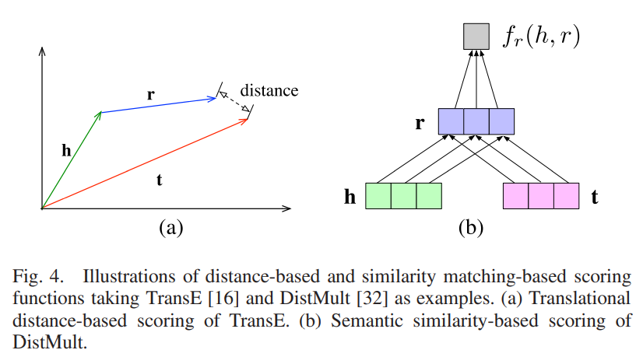
B) Scoring Function
2 types:
Distance based
Similarity based

Slide 23
Distance based Scoring Function

Slide 24
Similarity based Scoring Function

Slide 25
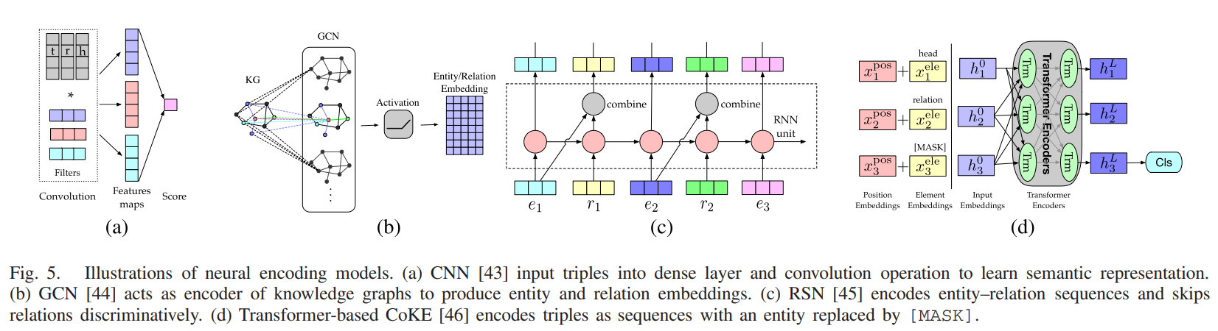
C) Encoding Models

Slide 26
3) Temporal KG
Current research focuses on, static KG where facts are not changed with time, while the temporal dynamics of a knowledge graph are less explored.
However, the temporal information is of great importance because the structured knowledge only holds within a specific period, and the evolution of facts follows a time sequence.
Recent research begins to take temporal information into KRL and KGC, which is termed temporal KG (TKG).
Research efforts have been made for learning temporal and relational embeddings simultaneously.

Slide 27
3) Temporal KG
Relevant models for dynamic network embedding also inspire temporal KGE.
For example, temporal graph attention (TGAT) network:
captures temporal–topological structure and learn time-feature interactions simultaneously may be useful to preserve temporal-aware relation for KG.

Slide 28
Why TKG? [2 NLSM]
Temporal information is of great importance because the structured knowledge only holds within a specific period, and the evolution of facts follows a time sequence.
Temporal dynamics of a knowledge graph are less explored.

Slide 29
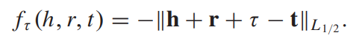
A) Temporal Information Embedding
Temporal information is considered in temporal-aware embedding by extending triples into temporal quadruple as (h,r,t,τ), where τ provides additional temporal information about when the fact held.
TTransE:
Leblay and Chekol [175] investigated temporal scope prediction over time-annotated triple and simply extended existing embedding methods.
For example, TransE with the vector-based TTransE defined as

Slide 30
A) Temporal Information Embedding
ConT:
Ma et al. [176] proposed ConT by replacing the shared weight vector of Tucker with a timestamp embedding.

Slide 31
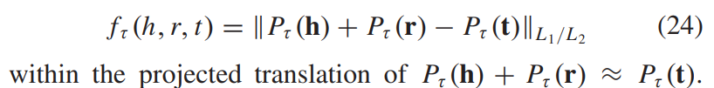
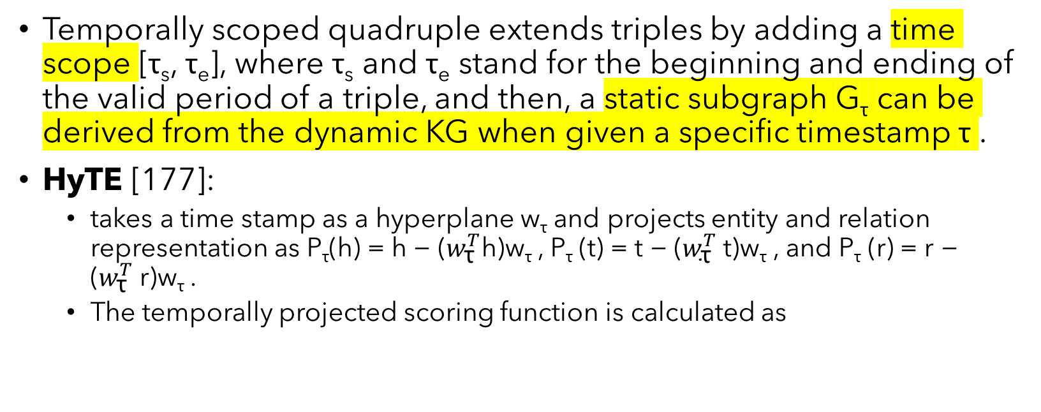
A) Temporal Information Embedding
Temporally scoped quadruple extends triples by adding a time scope [τ_{s}, τ_{e}], where τ_{s} and τ_{e} stand for the beginning and ending of the valid period of a triple, and then, a static subgraph G_{τ} can be derived from the dynamic KG when given a specific timestamp τ .
HyTE [177]:
takes a time stamp as a hyperplane w_{τ} and projects entity and relation representation as P_{τ}(h) = h − ($w_{\text{τ}}^{T}$h)w_{τ} , P_{τ} (t) = t − ($w_{\text{τ}}^{T}$t)w_{τ} , and P_{τ} (r) = r − ($w_{\text{τ}}^{T}$r)w_{τ} .
The temporally projected scoring function is calculated as

Slide 34
Neural Latent Space Model for Dynamic Networks and Temporal Knowledge Graphs

Slide 35
Abstract
Proposed: A statistical model for dynamically evolving networks, together with a variational inference approach.
NLSM:
Encodes edge dependencies across different time snapshots.
It represents nodes via latent vectors and uses interaction matrices to model the presence of edges.
Video: https://slideslive.com/38948961/neural-latent-space-model-for-dynamic-networks-and-temporal-knowledge-graphs

Slide 36
Network Analysis
With the advent of deep learning, network analysis methods more recently started focusing on representation learning techniques.
These methods learn finite vector representations or embeddings for nodes and edges that can be used for downstream tasks like link prediction (Grover and Leskovec 2016), node classification (Sen et al. 2008), community detection (Fortunato 2010), and so on.
Two kinds:
Homogeneous networks with only a single type of nodes and edges.
Heterogeneous networks with multiple types of nodes and edges.

Slide 37
Network Analysis: Homogeneous Networks
Uses random walk models to capture the neighborhood context (Perozzi, Al-Rfou, and Skiena 2014; Grover and Leskovec 2016).
The embeddings are learned so that nodes closer to each other have similar embeddings.

Slide 38
Network Analysis: Heterogeneous Networks
These networks can also be viewed as KG with different types of nodes as entities and different types of edges as relations between entities.
The modelling techniques developed for homogeneous networks are not applicable for KGs as the entities connected via a relation may not be similar.
For example, consider the edge (Barack Obama, Born in , USA) which represents a relation Born in between the entities Barack Obama and USA. Here, entities are not similar because Barack Obama is a person and USA is a country.

Slide 39
Network Analysis: Heterogeneous Networks
For representation learning in such heterogeneous networks, entities and relations are given a finite representation which is then used as input to a scoring function as in (Bordes et al. 2013; Dettmers et al. 2018; Sun et al. 2019).
The embeddings are learned so that the observed edges in the KG get a higher score as compared to the unobserved edges.

Slide 40
Temporal Property
One aspect that is often ignored by the existing methods is that most real-world networks evolve with time.
For example, in social networks, new friendship links are formed or broken with time. Similar observations can be made in KGs as there are relations with temporal properties.
For example, (Barack Obama, President of, USA) is valid only between 2009 and 2017. KGs which encode such facts are called temporal KGs. Here, the links change with time.
Owing to many practical applications, it is important to integrate both dynamic and heterogeneous information while modelling networks.

Slide 41
Temporal Property
Existing methods for dynamic homogeneous networks have used techniques such as:
Temporal regularization loss (Zhou et al. 2018; Goyal et al. 2018)
RNN based sequential architectures (Goyal, Chhetri, and Canedo 2020)
For modelling temporal KGs, previous methods have used:
Temporal point process models (Trivedi et al. 2017, 2019)
RNN based interaction history encoding model (Jin et al. 2019)
NLSM is the first method that considers homogeneous and heterogeneous networks in an unified manner.

Slide 42
i) Modelling Individual Snapshots
Time t ∈ {1, 2, . . . , T} is discrete.
The network evolution is therefore described by the corresponding network snapshots at each time-step, specified by binary adjacency matrices A (t) r ∈ {0, 1}^{N×N} , where N is the number of nodes in the network, r ∈ {1, 2, . . . , R} is the relation between the nodes, and t denotes the time.
We begin by discussing the case of homogeneous networks (R = 1). The extension to heterogeneous networks (R ≥ 2) is then straightforward and we present it in Section 2.3.
To avoid cluttering the notation, we drop the subscript in A (t) r when R = 1.
We further assume that there are no self-loops.
Each node is modeled by K attributes whose values lie in the interval [0, 1]. These attributes can change over time.
The latent vector z (t) n ∈ [0, 1]^{K} is used to denote the attributes for node n at time t.

Slide 44
Question Answering over Temporal Knowledge Graphs

Slide 45
Video: https://underline.io/lecture/25744-question-answering-over-temporal-knowledge-graphs

Slide 46
Question Answering

Slide 47
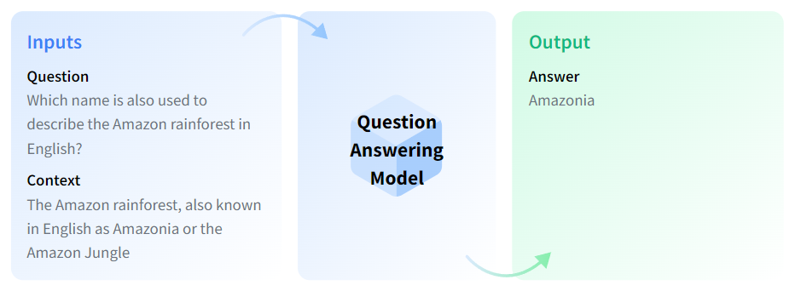
What?
QA models can retrieve the answer to a question from a given text, which is useful for searching for an answer in a document.
Some question answering models can generate answers without context.

Slide 48
Task Variants
There are different QA variants based on the inputs and outputs:
Extractive QA: The model extracts the answer from a context. The context here could be a provided text, a table or even HTML! This is usually solved with BERT-like models.
Open Generative QA: The model generates free text directly based on the context. You can learn more about the Text Generation task in its page.
Closed Generative QA: In this case, no context is provided. The answer is completely generated by a model.
The schema above illustrates extractive, open book QA. The model takes a context and the question and extracts the answer from the given context.
You can also differentiate QA models depending on whether they are open-domain or closed-domain. Open-domain models are not restricted to a specific domain, while closed-domain models are restricted to a specific domain (e.g. legal, medical documents).

Slide 49
GNN for NLP

Slide 50
Abstract
Although text inputs are typically represented as a sequence of tokens, there is a rich variety of NLP problems that can be best expressed with a graph structure.
Contents:
Graph Construction
Graph Representation Learning
Graph based Encoder-Decoder models
Applications

Slide 51
Introduction
Conventionally, text sequences are considered as a bag of tokens such as BoW and TF-IDF in NLP tasks.
Word Embeddings techniques (Mikolov et al., 2013; Pennington et al., 2014): sentences are typically represented as a sequence of tokens in NLP tasks.
Hence, popular deep learning techniques such as RNNs (Schuster and Paliwal, 1997) and CNNs (Krizhevsky et al., 2012) have been widely applied for modeling text sequence.

Slide 52
CS 244w

Slide 54
TransE
Translating Embeddings for Modeling Multi-relational Data

Slide 55
Abstract
TransE: models relationships by interpreting them as translations operating on the low-dimensional embeddings of the entities.

Slide 56
TransH
Knowledge Graph Embedding by Translating on Hyperplanes

Slide 58
TransR
Learning Entity and Relation Embeddings for Knowledge Graph Completion

Slide 60
Pickle

Slide 61
.pkl file
PKL file created by pickle => enables objects to be serialized to files on disk and deserialized back into the program at runtime.
It contains a byte stream that represents the objects.
Used to save space when being stored or transferred over a network then is unpickled and loaded back into program memory during runtime.

Slide 62
Event-centric Forecasting on Temporal Knowledge Graph with Transformer

Slide 63
Abstract
Event forecasting on the temporal knowledge graph (tKG), based on Hawkes process theories.
Implementation of transformer for temporal events encoding under Hawkes process assumption.
Modifications on the graph information integration method and hidden state decoding based on Hawkes process.

Slide 64
Introduction

Slide 65
Chart

Slide 66
Table
 | Category 1 | Category 2 | Category 3 | Category 4
Item 1 | 4.5 | 2.3 | 1.7 | 5
Item 2 | 3.2 | 5.1 | 4.4 | 3
Item 3 | 2.1 | 1.7 | 2.5 | 2.8
Item 4 | 4.5 | 2.2 | 1.7 | 7

Slide 67
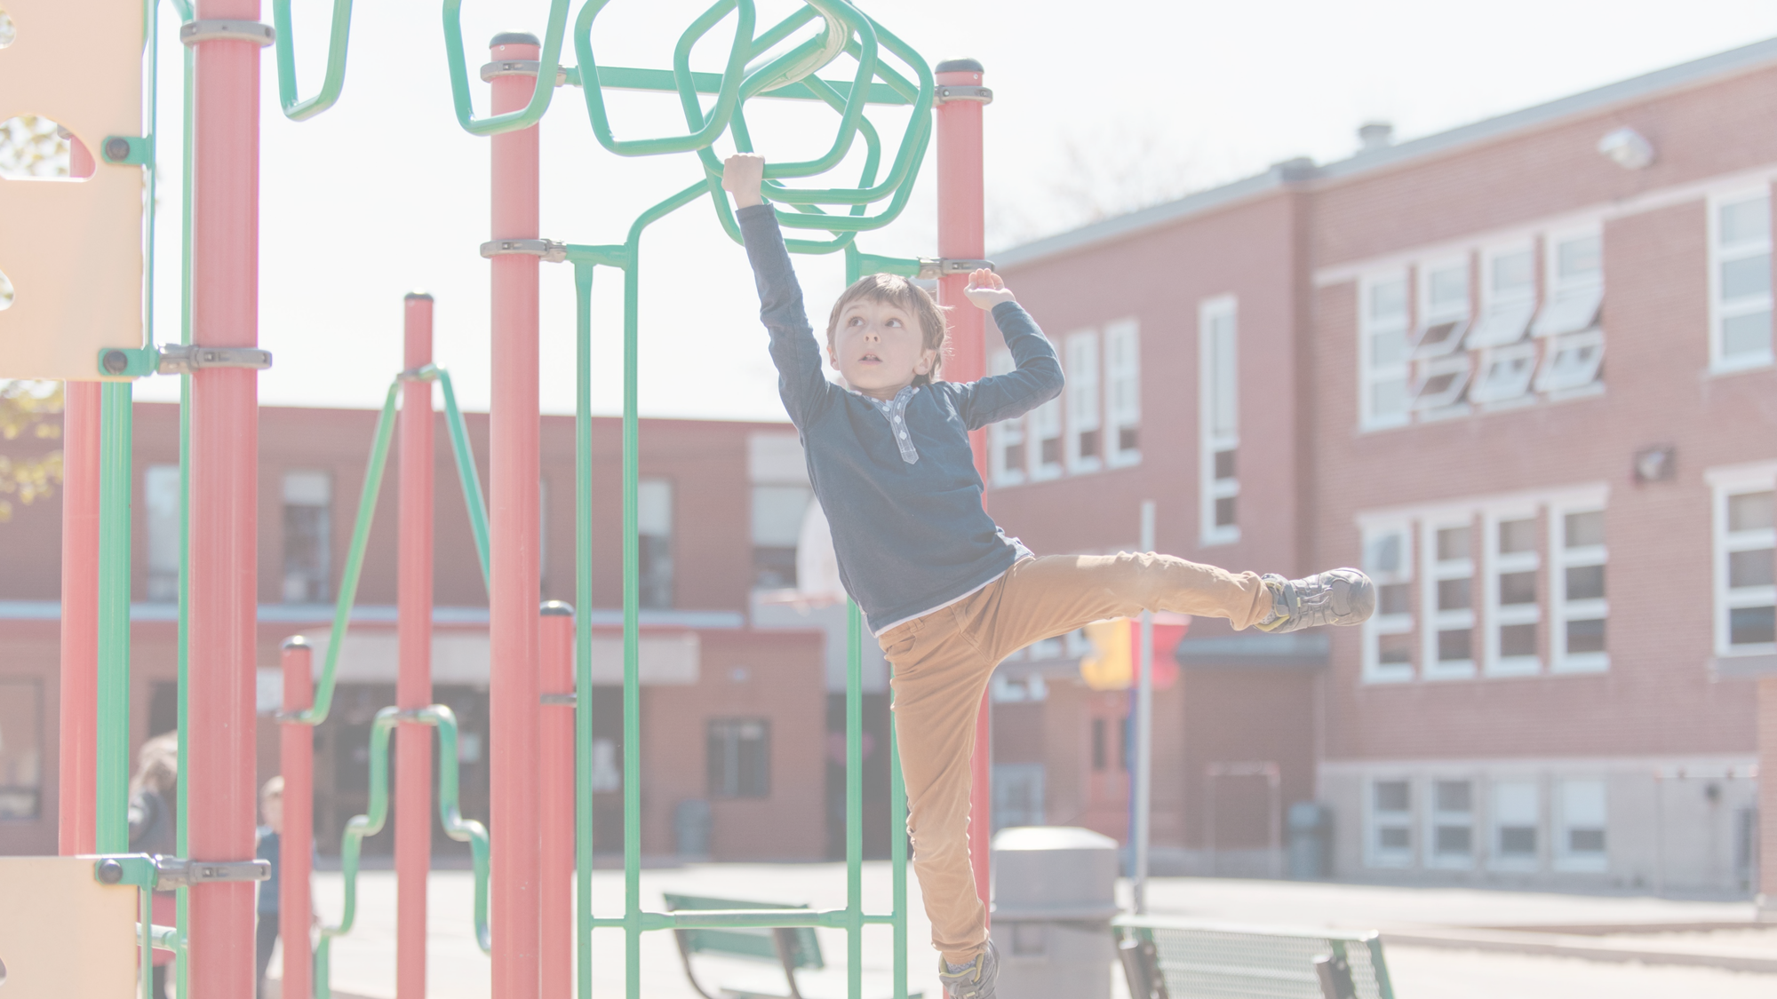
The way to get started is to quit talking and begin doing.
Walt Disney

Slide 68
Team
Name Title
Name Title
Name Title
Name Title

Slide 69
Timeline
To start a presentation, go to the Slide Show tab, and select From Beginning.
1
To display Presenter view, in Slide Show view, on the control bar at the bottom left select the three dots, and then Show Presenter View.
2
During your presentation, the speaker notes are visible on your monitor, but aren't visible to the audience.
3
The Notes pane is a box that appears below each slide. Tap it to add notes.
4
If you don’t see the Notes pane or it is completely minimized, click Notes on the task bar across the bottom of the PowerPoint window.
5

Slide 70
Content
Subtitle
Subtitle
Add text, images, art, and videos.
Add transitions, animations, and motion.
Save to OneDrive, to get to your presentations from your computer, tablet, or phone.
Open the Design Ideas pane for instant slide makeovers.
When we have design ideas, we’ll show them to you right there.

Slide 71
Content
Subtitle
Subtitle
Subtitle
Add text, images, art, and videos.
Add transitions, animations, and motion.
Save to OneDrive, to get to your presentations from your computer, tablet, or phone.
Open the Design Ideas pane for instant slide makeovers.
When we have design ideas, we’ll show them to you right there.
This PowerPoint theme uses its own unique set of colors, fonts, and effects to create the overall look and feel of these slides.
PowerPoint has tons of themes to give your presentation just the right personality.

Slide 72
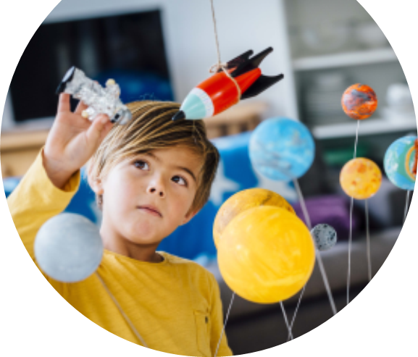
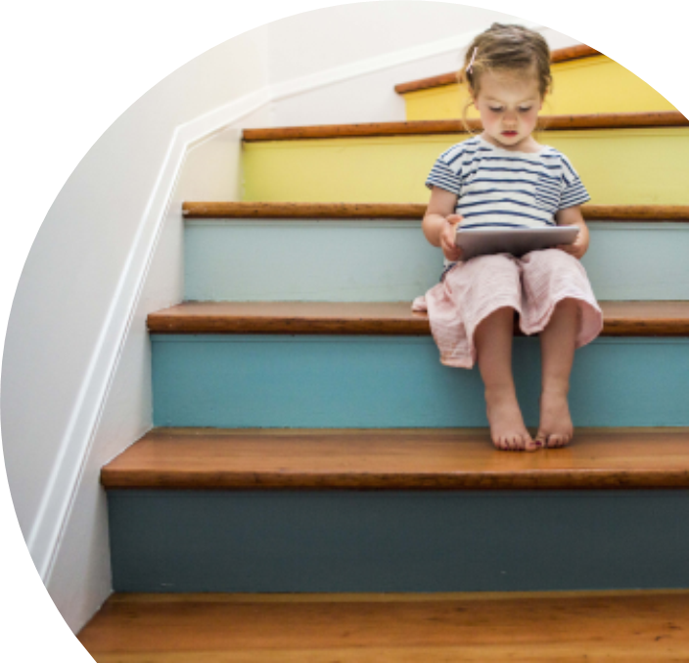
Summary
With PowerPoint, you can create presentations and share your work with others, wherever they are. Type the text you want here to get started. You can also add images, art, and videos on this template. Save to OneDrive and access your presentations from your computer, tablet, or phone.

Slide 73
Thank you
Presenter name
Email address
Website

